Slide 1
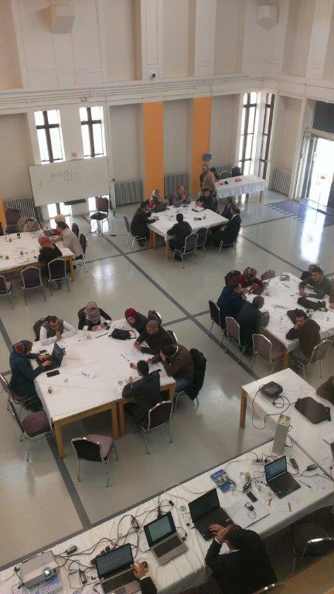



Local INVENT Meeting
27 September, 2016
JUST
Preparation for the Electronic Town Meeting (ETM)

Slide 2
What is the Electronic Town Meeting?
Electronic Town Meeting (ETM) is a community forum that gives participants an opportunity to deliberate their ideas and opinions with the help of digital technology
ETM is an effective way for practicing democracy, expressing opinions and constructive debate that explores public opinion and find innovative solutions to the issues of concern to the collective opinion of the participants

Slide 3
The fundamental characteristics of the Electronic Town Meeting
information on the subject under discussion, is given to the participants
the participants express their opinions individually in small groups (also known as table)

Slide 4
1- Facilitator
A Facilitator with an experience in the field of debate runs the discussion on the table
2- Rapporteur
records the events of the debate immediately on a computer is linked to the central network of the forum and thanks to this technology the opinion of each participant is reported without the influence of a facilitator of debate, so that the general outcome of the debate will reflect the individual opinion of each person participated in the dialogue
3-Theme Teams
collect instant feedback from rapporteurs and edit it without interfering its content or attempts to standardize it, but they must highlight the points of contention that are collected and voted during the debate individually and secretly by all participants

Slide 5

Electronic Town Meeting staff key roles
No. | ROLE | DESCRIPTION | NAME
1 | EVENT PRESENTER | Person responsible for the running of the ETM event. He/she will introduce the guests, the objectives and themes of the day to the participants and launching - in strong coordination with te event director – the discussion and polling sessions. | Fahmi
2 | EVENT DIRECTION | Person in charge of the direction and control of the software to manage the timing of the discussion and polling sessions. He works in a strong coordination with the presenter. | Fahmi
4 | POLLS ELABORATION | Person in charge of analysing the discussion and elaborating in real time questions to be voted.
5 | INSTANT REPORT EDITING | The person who edits the instant report, adds photos of the meeting, diagrams and graphic details and print out the final version. Skills required: writing skills to intervene on the text (paragraphs, titles, etc); advanced knowledge of editing/word processing software | Qatada
6 | IT STAFF | People in charge of installing the system (hardware+software) and monitoring it during the Electronic Town Meeting. | Fahad
7 | WELCOME/REGISTRATION | staff in charge of the registration and welcome of the participants.
8 | THEME TEAM LEADER | He/She receives the text flows from the TTM

Slide 6
No. | ROLE | DESCRIPTION | NAME
9 | THEME TEAM MEMBER | He/She receives flows from Table 1_2
10 | THEME TEAM MEMBER | He/She receives flows from Table 3_4
11 | THEME TEAM MEMBER | He/She receives flows from Table 5_6
12 | FACILITATOR | He/She manages and facilitates discussion at table no. 1 | Osamah
15 | RAPPORTEUR | He/She reports discussion at table no. 1 | Hala
16 | FACILITATOR | He/She manages and facilitates discussion at table no. 2 | Muhannad
17 | RAPPORTEUR | He/She reports discussion at table no. 2 | Rana
18 | FACILITATOR | He/She manages and facilitates discussion at table no. 3 | Y. Abdallat
19 | RAPPORTEUR | He/She reports discussion at table no. 3
20 | FACILITATOR | He/She manages and facilitates discussion at table no.4 | Hamdan
21 | RAPPORTEUR | He/She reports discussion at table no. 4
22 | FACILITATOR | He/She manages and facilitates discussion at table no. 5 | Mutah
23 | RAPPORTEUR | He/She reports discussion at table no. 5
24 | FACILITATOR | He/She manages and facilitates discussion at table no. 6 | Al-Mothedah
25 | RAPPORTEUR | He/She reports discussion at table no. 6

Slide 7
    Advantages of Electronic Town Meeting
The outcomes of ETM reflect the views of all participants and give them the opportunity to give their opinion
It constitutes an opportunity for interested parties in a subject or a case to meet exchange their views and discuss problems
ETM constitutes an opportunity for politicians and decision makers by measuring the opinions of experts and citizens and discussing issues

Slide 8
Advantages of Electronic Town Meeting
Saving time and effort using modern technology. ETM (creative idea, needs available, easy and inexpensive resources)
You can imagine without this technology how the views of some tens or hundreds of participants are to be measured in a limited time accurately,for sensitive topics that involve different parties and multiple perspectives and interests.
Participants must reflect all stakeholders on topics under discussion so that the debate takes into account the interests of all parties.

Slide 9

THANK YOU

